Slide 1
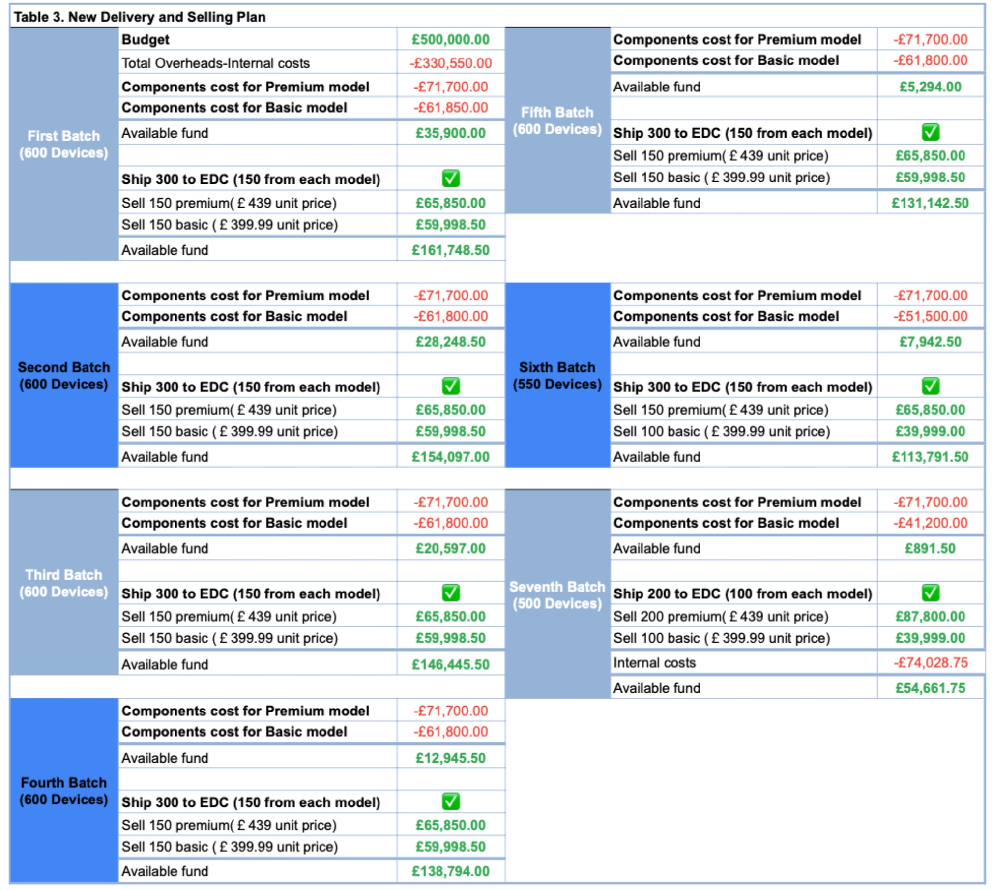
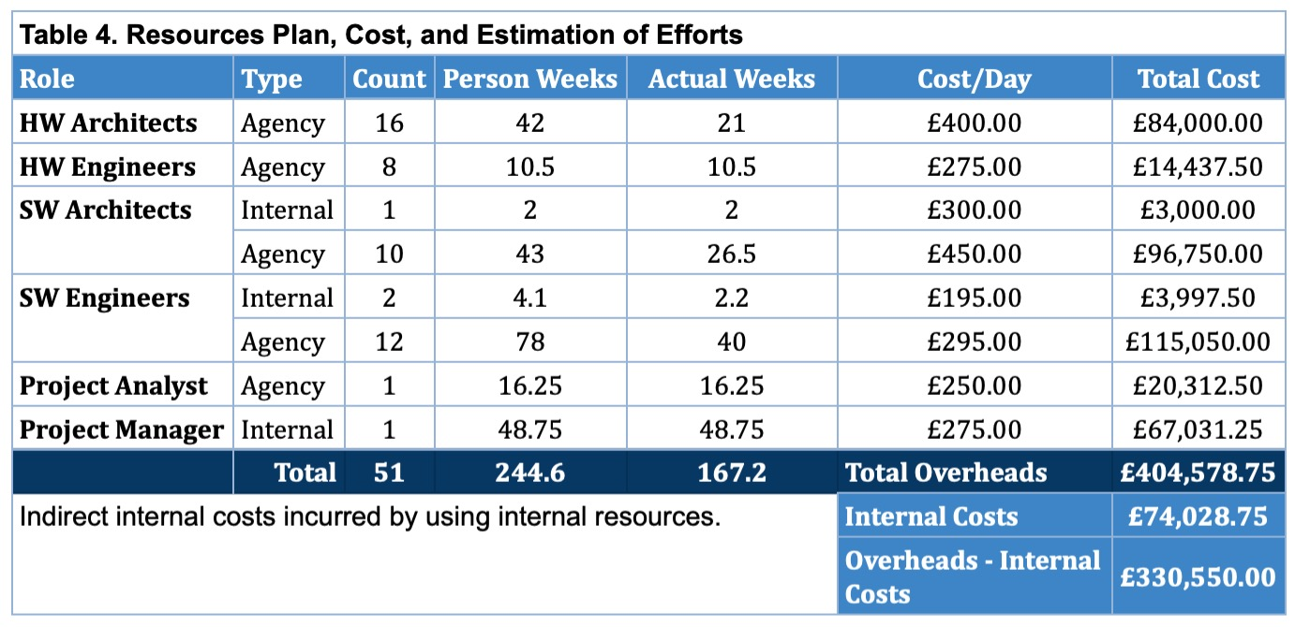

Projected Resources and Estimation of Efforts
Notes:
Hi, my name is Aaron Aubeck, and I will be going through the projected resources and estimation efforts as well as the projected profit with you today.
As you can see on this slide, table 4 shows the resources plan and cost and the estimation of efforts.
We have calculated that a total of 51 individuals will be working on the project, this will consist of, four internal employees, including the project manager, and the remaining resources will be hired in though agency work.
We have considered that a total effort of 244.6 person weeks will be needed for this project, excluding the time required to assemble and deliver the devices for which it has been assumed that Synful computing will use their usual assembly line.
The project has been estimated to last for 20 months. Throughout this period the project manager will be hired 75% of the time and the project analyst 25% of the time until 1200 devices are delivered to the EDC.
Once that number has been fulfilled their availability will be diminished until the end of the project.
This helps to reduce costs, with the confidence that the project is expected to run smoothly after completing all the design and testing stages and delivering a total of 2400 devices.
The overhead cost from the design and implementation of the project will be £330,550, excluding the indirect cost of using internal resources, which will be £74,028.75.
The cost to deliver the final product will be compensated from the profit acquired and has not been included in the end of the project schedule after delivering all completed units to the EDC.
The overhead costs will be covered during the first batch of assembly and delivery, as shown in Table 3.
As you can see the units will be completed in 7 batches, this is to aid in the cost of manufacturing deliverables and to support timings in manufacturing parts for the units.
The batch and selling plan ensures the company accounts do not take on debt throughout the entire project, apart from internal costs. By the end of the seventh batch, Synful Computing will have covered all the project overheads, including these internal costs. The EDC order will also be completed in full.

Slide 2

Projected Profit
After seven batches:
All overheads, including internal costs, will be covered
Expected profit is £54,661.75
Profit for every computer sold after this time is £200 per device
Notes:
It is estimated that the expected profit at this stage will be £54,661.75. After that, each device is expected to generate a profit of £200.
So, to summarise,
A total of 51 individuals will be required to complete work.
244.6 person weeks will be required to fulfill this project with an estimation of lasting for 20 months.
Overhead cost from design to implementation will be £330,550 with cost of internal resources being £74,028.75.
All costs will be compensated from profit acquired and will generate a profit after the 7th batch of £54,661.75 with each device after that generating a profit of £200.

